Slide 1
ATAI
Advanced Techniqueof Artificial Intelligence
ATAI
ChongqingUniversity _{AdvancedTechniqueof}
of Technology Artificial Intelligence
Chongqing University of
Technology
Chongqing University ^{ATAI}
_{of Technology} Advanced Techniqueof
Artificial Intelligence
Chongqing University of Technology
Chongqing University of Technology
Graph Interactive Network with Adaptive Gradient for
Multi-Modal Rumor Detection
Code: None
2023.12.3 •ChongQing
—— ICMR 2023
Reported by Ling Tan
1

Slide 2
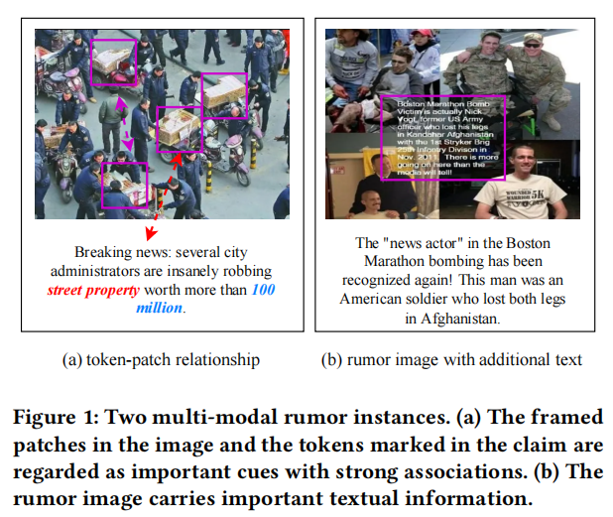
ATAI
AdvancedTechniqueof
Artificial Intelligence
ATAI
ChongqingUniversity _{AdvancedTechniqueof}
of Technology Artificial Intelligence
ChongqingUniversity of Technology
Motivation
（1） most models simply concatenate text features and image features, or use coarse-grained fusion strategies, which cannot fully mine effective information within and between modalities. More specifically,they often ignore the interactions and long-distance dependencies between text tokens and image patches that may become evidence clues.
（2）The text embedded in the rumor image in Figure 1(b) has proved to be one of the key clues, but how to more effectively fuse the feature into the rumor detector remains to be investigated.

Slide 3
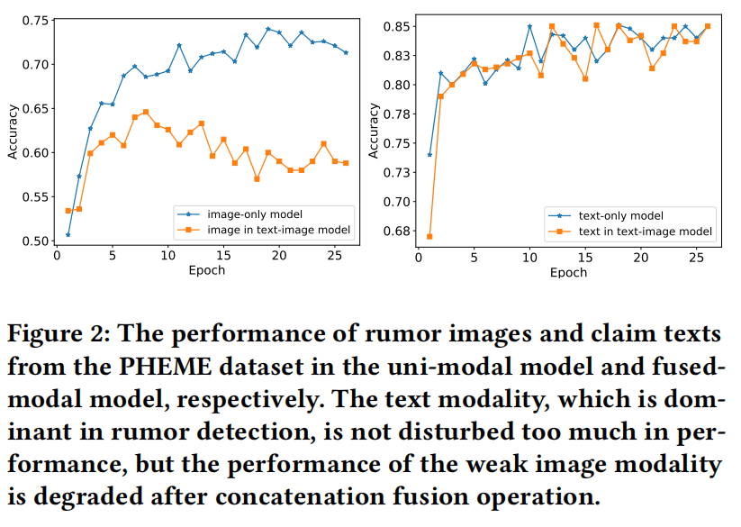
ATAI
AdvancedTechniqueof
Artificial Intelligence
ATAI
ChongqingUniversity _{AdvancedTechniqueof}
of Technology Artificial Intelligence
ChongqingUniversity of Technology
Motivation
（3） Generally, text is the main manifestation of rumors, while images are mostly auxiliary, which may lead to the rumor detector being dominated by text features in the training process and inhibit the optimization of image features.

Slide 4
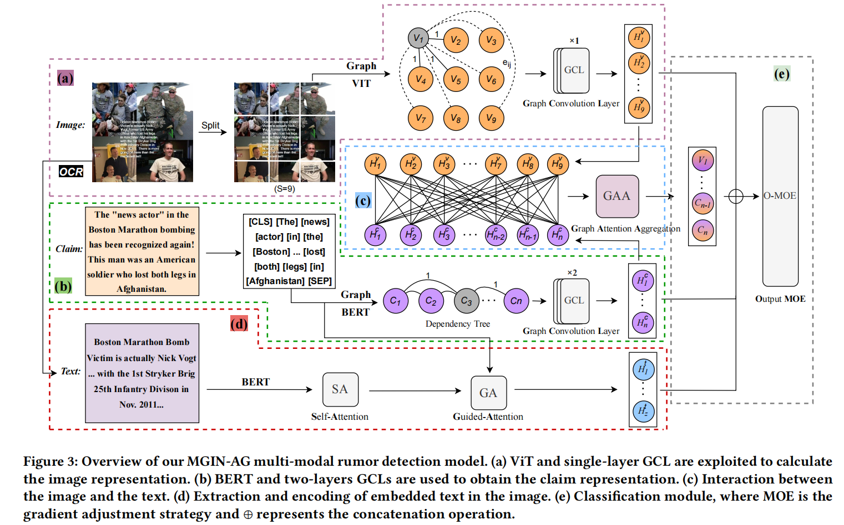
ChongqingUniversity of Technology
ATAI
AdvancedTechniqueof
Artificial Intelligence
ATAI
ChongqingUniversity _{AdvancedTechniqueof}
of Technology Artificial Intelligence
Overview

Slide 5
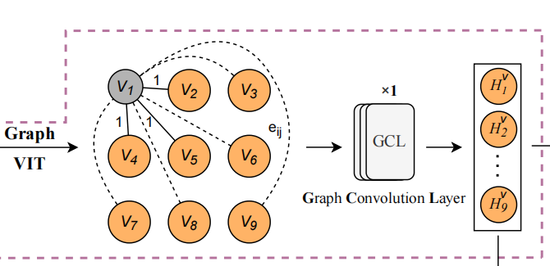
ChongqingUniversity of Technology
ATAI
AdvancedTechniqueof
Artificial Intelligence
ATAI
ChongqingUniversity _{AdvancedTechniqueof}
of Technology Artificial Intelligence
Overview

Slide 6
ChongqingUniversity of Technology
ATAI
AdvancedTechniqueof
Artificial Intelligence
ATAI
ChongqingUniversity _{AdvancedTechniqueof}
of Technology Artificial Intelligence
Overview

Slide 7
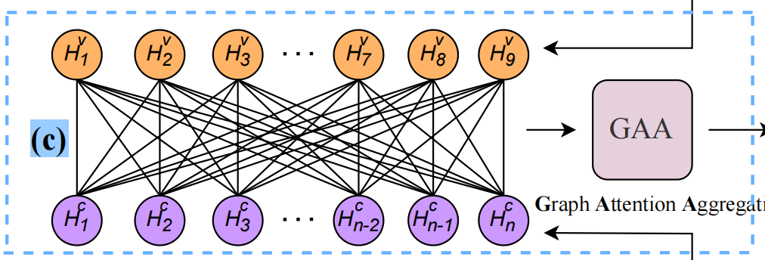
ChongqingUniversity of Technology
ATAI
AdvancedTechniqueof
Artificial Intelligence
ATAI
ChongqingUniversity _{AdvancedTechniqueof}
of Technology Artificial Intelligence
Method

Slide 8
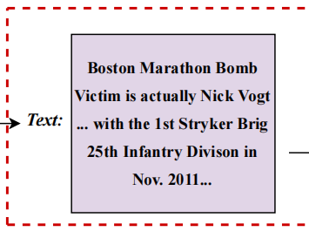
ChongqingUniversity of Technology
ATAI
AdvancedTechniqueof
Artificial Intelligence
ATAI
ChongqingUniversity _{AdvancedTechniqueof}
of Technology Artificial Intelligence
Method

Slide 9
ChongqingUniversity of Technology
ATAI
AdvancedTechniqueof
Artificial Intelligence
ATAI
ChongqingUniversity _{AdvancedTechniqueof}
of Technology Artificial Intelligence
Method

Slide 10
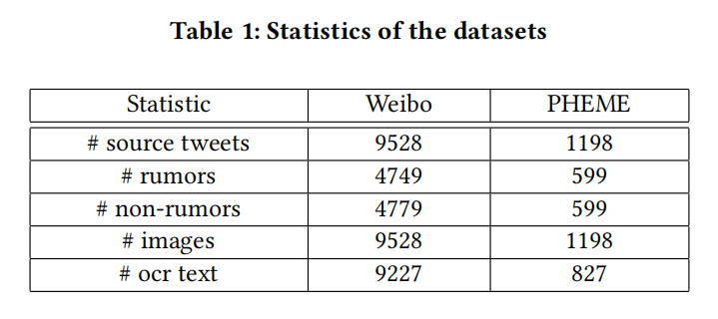
ATAI
AdvancedTechniqueof
Artificial Intelligence
ATAI
ChongqingUniversity _{AdvancedTechniqueof}
of Technology Artificial Intelligence
ChongqingUniversity of Technology
Experiments

Slide 11
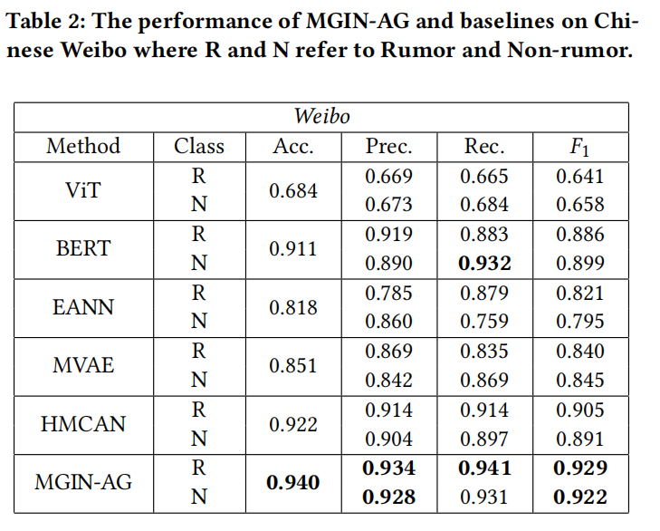
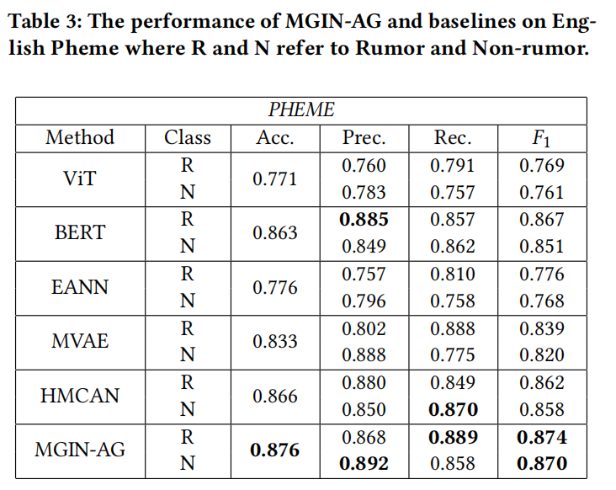
ATAI
AdvancedTechniqueof
Artificial Intelligence
ATAI
ChongqingUniversity _{AdvancedTechniqueof}
of Technology Artificial Intelligence
ChongqingUniversity of Technology
Experiments

Slide 12
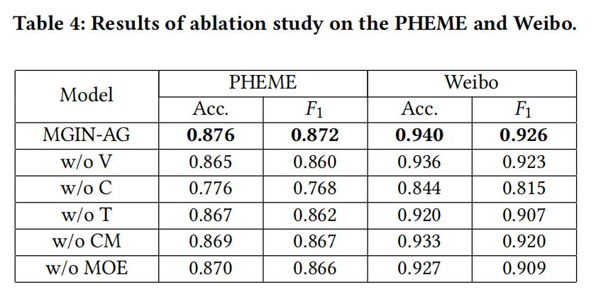
ATAI
AdvancedTechniqueof
Artificial Intelligence
ATAI
ChongqingUniversity _{AdvancedTechniqueof}
of Technology Artificial Intelligence
ChongqingUniversity of Technology
Experiments

Slide 13
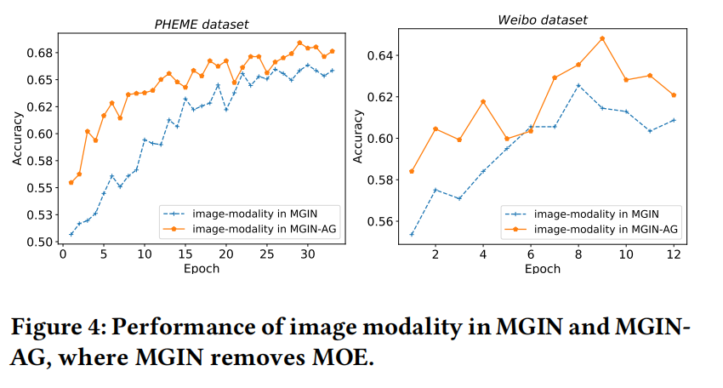
ATAI
AdvancedTechniqueof
Artificial Intelligence
ATAI
ChongqingUniversity _{AdvancedTechniqueof}
of Technology Artificial Intelligence
ChongqingUniversity of Technology
Experiments

Slide 14
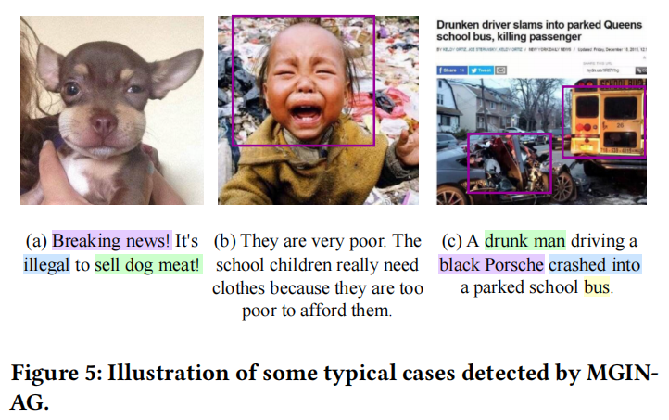
ATAI
AdvancedTechniqueof
Artificial Intelligence
ATAI
ChongqingUniversity _{AdvancedTechniqueof}
of Technology Artificial Intelligence
ChongqingUniversity of Technology
Experiments

Slide 15
ChongqingUniversity of Technology
ATAI
AdvancedTechniqueof
Artificial Intelligence
ATAI
ChongqingUniversity _{AdvancedTechniqueof}
of Technology Artificial Intelligence
Thanks!

